Slide 1
MIS 637
Data Analytics & Machine Learning
Course Review &
k-Nearest Neighbor Algorithm
M. Daneshmand
MD-MIS637-Fall 2020

Slide 2
Supervised vs. Unsupervised Methods
Data Analytics & ML methods are categorized as either Unsupervised or Supervised
Unsupervised Methods
  A target variable is not specified
  Instead, the algorithm searches for patterns and structure among the variables
  Clustering is the most common unsupervised method
  For example, political consultants analyze voter clusters in congressional districts that may be responsive to their particular candidate
  Important variables such as gender, age, income, and race are input to the clustering algorithm
MD-MIS637-Fall 2020

Slide 3
Supervised vs. Unsupervised Methods (cont’d)
  Voter profiles for fund-raising and advertising are created
Supervised Methods
  A target variable is specified
  The algorithm “learns” from the examples by determining which values of the predictor variables are associated with different values of the target variable
  For example, the regression methods discussed in Chapter 4 are supervised. The observed values of the response (target) variable are read by the least-squares algorithm, while it attempts to minimize the prediction error
  All classification methods in Chapters 5 – 7 are supervised methods including: Decision Trees, Neural Networks, and k-Nearest Neighbors
MD-MIS637-Fall 2020

Slide 4
Methodology for Supervised Modeling
Supervised data mining methods use Training, Test, and Validation data sets as part of the model building and evaluation process
Training
  The Training Set includes records with predictor variables and pre-classified values for the target variable
  This is the initial stage where a provisional data mining model is built using the training set
  The model “learns” from the examples in the training set
  What happens if the model blindly applies all patterns learned from the training set to future data?
MD-MIS637-Fall 2020

Slide 5
Methodology for Supervised Modeling (cont’d)
  For example, suppose every customer in a training set named “David” happens to be in the high-income bracket
  A data mining model that “memorizes” this idiosyncrasy in the training set is actually overfitting the data
  Most likely we would not want our model to apply this rule to future or unseen data
  Therefore, the next step in the process is to examine the performance of the provisional data model using a different set of data
MD-MIS637-Fall 2020

Slide 6
Methodology for Supervised Modeling (cont’d)
Testing
  The Test Set is a “holdout” set of data independent from the training set that was used to build the provisional data model
  The true values of the target variable in the test set are hidden temporarily from the provisional data model
  The provisional data model simply classifies the records in the test set according to the rules and patterns it learned from the records in the training set
  The performance of the provisional data model is evaluated by comparing its classifications against the actual values of the target variable
  The provisional data model is then adjusted in an effort to minimize the error rate on the test set
MD-MIS637-Fall 2020

Slide 7
Methodology for Supervised Modeling (cont’d)
Validation
  Next, the adjusted data model is applied to another set of data called the Validation Set
  The validation set is another “holdout” set of data independent of the training and test sets
  The performance of the adjusted data model is evaluated against the validation set
  If required, the adjusted data model is modified to minimize the error rate on the validation set
  Estimates of data model performance for future, unseen data are computed using evaluative measures applied to results obtained when classifying the validation set
MD-MIS637-Fall 2020

Slide 8
Methodology for Supervised Modeling (cont’d)
Use training set to generate a provisional data mining model.
Provisional
data mining model.
Training Set
(pre-classified)
Apply provisional model
to test set. Adjust provisional model
to minimize error rate
on test set.
Adjusted
data mining model.
Test Set
Apply adjusted model
to validation set. Adjust the adjusted model to minimize error rate on validation set.
“Final”
data mining model.
Validation Set
MD-MIS637-Fall 2020

Slide 9
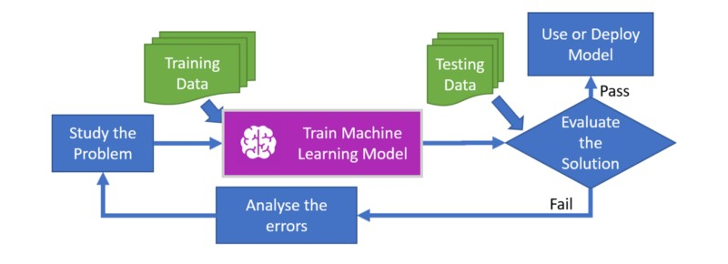
MD-MIS637-Fall 2020

Slide 10
k-Nearest Neighbor Algorithm
  The k-Nearest Neighbor algorithm is an example of instance-based learning where training set records are first stored
  Next, the classification of a new unclassified record is performed by comparing it to records in the training set it is most similar to
  k-Nearest Neighbor is used most often for classification, although it is also applicable to estimation and prediction tasks
Example: Patient 1
  Recall from Chapter 1 that we were interested in classifying the type of drug a patient should be prescribed
  The training set consists of 200 patients with Na/K ratio, age, and drug attributes
  Our task is to classify the type of drug new a patient should be prescribed that is 40-years-old and has a Na/K ratio of 29
MD-MIS637-Fall 2020

Slide 11
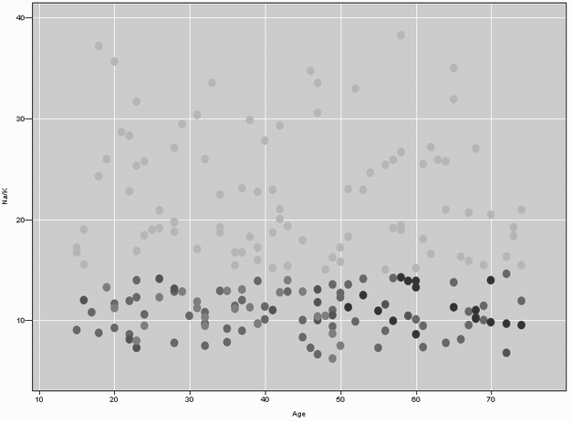
k-Nearest Neighbor Algorithm (cont’d)
  This scatter plot of Na/K against Age shows the records in the training set that patients 1, 2, and 3 are most similar to
  A “drug” overlay is shown where Light points = drug Y, Medium points = drug A or X, and Dark points = drug B or C
Patient 1
Patient 2
Patient 3
MD-MIS637-Fall 2020

Slide 12
k-Nearest Neighbor Algorithm (cont’d)
  Which drug should Patient 1 be prescribed?
  Since Patient 1’s profile places them in the scatter plot near patients prescribed drug Y, we classify Patient 1 as drug Y
  All points near Patient 1 are prescribed drug Y, making this a straightforward classification
Example: Patient 2
  Next we classify a new patient who is 17-years-old with a Na/K ratio = 12.5. A close-up shows the neighborhood of training points in close proximity to Patient 2
C
Patient2
A
B
MD-MIS637-Fall 2020

Slide 13
k-Nearest Neighbor Algorithm (cont’d)
  Suppose we let k = 1 for our k-Nearest Neighbor algorithm
  This means we classify Patient 2 according to whichever single point in the training set it is closet to
  In this case, Patient 2 is closest to the Dark point, and therefore we classify them as drug B or C
  Suppose we let k = 2 and reclassify Patient 2 using k-Nearest Neighbor
  Now, Patient 2 is closest to a Dark point and Medium point
  How does the algorithm decide which drug to prescribe?
  A simple voting scheme does not help
MD-MIS637-Fall 2020

Slide 14
k-Nearest Neighbor Algorithm (cont’d)
  However, with k = 3, voting determines that two of the three closet points to Patient 2 are Medium
  Therefore, Patient 2 is classified as drug A or X
  Note that the classification of Patient 2 differed based on the value chosen for k
Example: Patient 3
  Patient 3 is 47-years-old and has a Na/K ratio of 13.5. A close-up shows Patient 3 in the center, with the closest 3 training data points
MD-MIS637-Fall 2020

Slide 15
k-Nearest Neighbor Algorithm (cont’d)
  With k = 1, Patient 3 is closest to the Dark point, based on a distance measure
  Therefore, Patient 3 is classified as drug B or C
  Using k = 2 or k = 3, voting does not help since each of the three nearest training points have different target values
Considerations when using k-Nearest Neighbor
  How many neighbors should be used? k = ?
  How is the distance between points measured?
  How is the information from two or more neighbors combined when making a classification decision?
  Should all points be weighted equally, or should some points have more influence?
MD-MIS637-Fall 2020

Slide 16
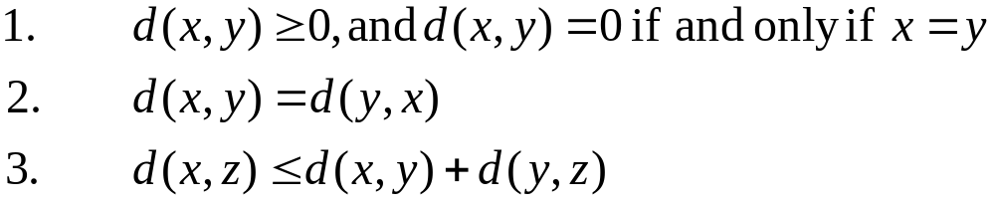
Distance Function
  How is similarity defined between an unclassified record and its neighbors?
  A distance metric is a real-valued function d used to measure the similarity between coordinates x, y, and z with properties:
  Property 1: Distance is always non-negative
  Property 2: Commutative, distance from “A to B” is distance from “B to A”
  Property 3: Triangle inequality holds, distance from “A to C” must be less than or equal to distance from “A to B to C”
MD-MIS637-Fall 2020

Slide 17
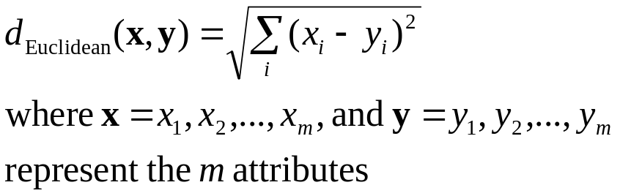
Distance Function (cont’d)
  The Euclidean Distance function is commonly-used to measure distance
Example
  Suppose Patient A is 20-years-old and has a Na/K ratio = 12, and Patient B is 30-years-old and has a Na/K ratio = 8
  What is the Euclidean distance between these instances?
MD-MIS637-Fall 2020

Slide 18
Distance Function (cont’d)
  When measuring distance, one or more attributes can have very large values, relative to the other attributes
  For example, income may be scaled 30,000-100,000, whereas years_of_service takes on values 0-10
  In this case, the values of income will overwhelm the contribution of years_of_service
  To avoid this situation we use normalization
Normalization
  Continuous data values should be normalized using Min-Max Normalization or Z-Score Standardization
MD-MIS637-Fall 2020

Slide 19
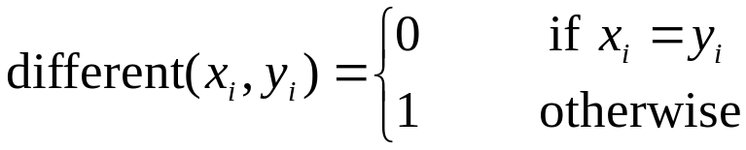
Distance Function (cont’d)
  For categorical attributes, the Euclidean Distance function is not appropriate
  Instead, we define a function called “different”
  We substitute different(x,y) for each categorical attribute in the Euclidean Distance function
Example
  Which patient is more similar to a 50-year-old male: a 20-year-old male or a 50-year-old female?
MD-MIS637-Fall 2020

Slide 20




Distance Function (cont’d)
  Let Patient A = 50-year-old male, Patient B = 20-year-old male, and Patient C = 50-year-old female
  Suppose that the Age variable has a range = 50, minimum = 10, mean = 45, and standard deviation = 15
  The table contains original, Min-Max Normalized, and Z-Score Standardized values for Age
Patient | Age | Age_{MMN} | Age_{Zscore} | Gender
A | 50 |  |  | Male
B | 20 |  |  | Male
C | 50 |  |  | Female
MD-MIS637-Fall 2020

Slide 21
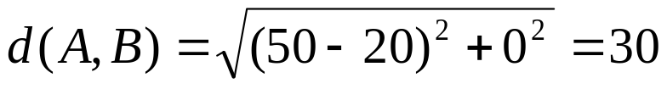
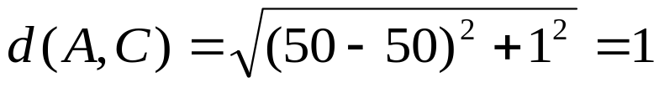
Distance Function (cont’d)
Age not normalized
  Assume we do not normalize Age and calculate the distance between Patient A and Patient B, and Patient A and Patient C
  We determine, although perhaps incorrectly, that Patient C is nearest Patient A
  Is Patient B really 30 times more distant than Patient C is to Patient A?
  Perhaps neglecting to normalize the values of Age is creating this discrepancy?
MD-MIS637-Fall 2020

Slide 22
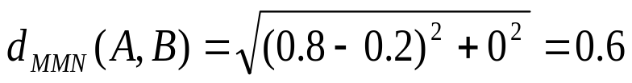
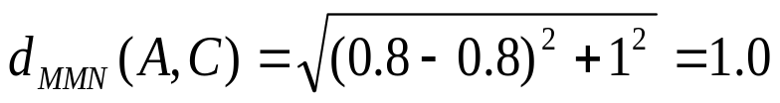
Distance Function (cont’d)
Age Normalized using Min-Max
  Age is normalized using Min-Max Normalization. Values lie in the range [0, 1]
  Again, we calculate the distance between Patient A and Patient B, and Patient A and Patient C
  In this case, Patient B is now closer to Patient A
Age Standardized using Z-Score
  This time, Age is standardized using Z-Score Standardization
MD-MIS637-Fall 2020

Slide 23


Distance Function (cont’d)
  Using Z-Score Standardization, most values are typically contained in the range [-3, 3]
  Now, Patient C is nearest Patient A. This is different from the results obtained using Min-Max Normalization
Conclusion
  The use of different normalization techniques resulted in Patient A being nearest to different patients in the training set
  This underscores the importance of understanding which technique is being used
MD-MIS637-Fall 2020

Slide 24
Distance Function (cont’d)
  Note that the distance(x,y) and Min-Max Normalization functions produce values in the range [0, 1]
  Perhaps, when calculating the distance between records containing both numeric and categorical attributes, the use of Min-Max Normalization is preferred
MD-MIS637-Fall 2020

Slide 25
Combination Function
  The Euclidean Distance function determines the similarity of a new unclassified record to those in the training set
  How should the most similar (k) records combine to provide a classification?
Simple Unweighted Voting
  This is the most simple combination function
  Decide on the value for k to determine the number of similar records that “vote”
  Compare each unclassified record to its k nearest (most similar) neighbors according to the Euclidean Distance function
  Each of the k similar records vote
MD-MIS637-Fall 2020

Slide 26
Combination Function (cont’d)
  Recall that we classified a new patient 17-years-old with a Na/K ratio = 12.5, using k = 3
  Simple unweighted voting determined that two of the three closet points to Patient 2 are Medium
  Therefore, Patient 2 is classified as drug A or X with a confidence of 2/3 = 66.67%
  We also classified a new patient 47-years-old that has a Na/K ratio of 13.5, using k = 3
  However, simple unweighted voting did not help and resulted in a tie
  Perhaps weighted voting should be considered?
MD-MIS637-Fall 2020

Slide 27
Weighted Voting
Weighted Voting
  In this case, the closer the neighbor, the more influence it has in the classification decision
  This method assumes a closer neighbor is more similar, and therefore its vote should be weighted more heavily, as compared that of more distant neighbors
  The weight of particular record is inversely proportional to its distance to the unclassified record
  A “tie” is unlikely to occur using this approach
MD-MIS637-Fall 2020

Slide 28
Weighted Voting (cont’d)
Example
  Again, recall that we classified a new patient 17-years-old with a Na/K ratio = 12.5, using k = 3
  We determined, using unweighted voting, two of the closest points were Medium, and the third was Dark
  However, the Dark point is the most similar to the new patient
  Now, we reclassify the new patient using a weighted voting scheme using values from the table below
Record | Age | Na/K | Age_{MMN} | Na/K_{MMN}
New Patient | 17 | 12.5 | 0.05 | 0.25
A (Dark) | 16.8 | 12.4 | 0.0467 | 0.2471
B (Med) | 17.2 | 10.5 | 0.0533 | 0.1912
C (Med) | 19.5 | 13.5 | 0.0917 | 0.2794
MD-MIS637-Fall 2020

Slide 29
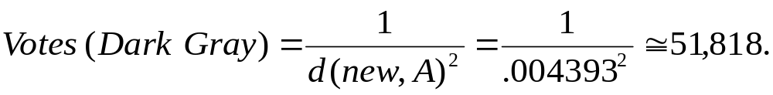
Weighted Voting (cont’d)
  The distance of records A, B, and C to the new patient are:
  Next, the votes of these records are weighted according to the inverse square of their distance to the new record
  Record A votes to classify the new patient as Dark (drug B or C)
MD-MIS637-Fall 2020

Slide 30
Weighted Voting (cont’d)
  Records B and C vote to classify the new patient as Medium (drug A or X)
  Convincingly (51,818 vs. 672) the weighted voting method classifies the new patient as Dark (drug B or C)
  Note that this procedure reverses our classification decision determined using unweighted voting, k = 3
  The inverse distance of 0 is undefined using weighted voting
  Theoretically, the value of k could be increased, such that all training records participate in voting; however, the computational complexity may result in poor performance
MD-MIS637-Fall 2020

Slide 31
Quantifying Attribute Relevance: Stretching the Axes
  Not all attributes may be relevant to classification
  For example, Decision Trees only include attributes that contribute to improving classification accuracy
  In contrast, k-Nearest Neighbor’s default behavior is to calculate distances using all attributes
  A relevant record may be proximate for important variables, while at the same time very distant for other, unimportant variables
  Taken together, the relevant record may now be moderately far away from the new record, such that it does not participate in the classification decision
MD-MIS637-Fall 2020

Slide 32
Quantifying Attribute Relevance: Stretching the Axes (cont’d)
  Perhaps, we should consider restricting the algorithm to using the most important fields for classification
  However, rather than making this determination a priori, we can make attributes either more, or less important
  This is accomplished using cross-validation or applying domain knowledge expertise
Stretching the Axes
  Stretching the Axes finds the coefficient zj by which to multiply the jth axis. Larger values of zj are associated with the more important variable axes
Cross-validation
  Cross-validation selects a random subset of data from the training set and determines the set of z1, z2, ..., zm that minimize the classification error on the test set
MD-MIS637-Fall 2020

Slide 33
Quantifying Attribute Relevance: Stretching the Axes (cont’d)
  Repeating the process leads to a more accurate set of values for z1, z2, ..., zm
Domain Expertise
  Alternately, we may call upon domain experts to recommend values for z1, z2, ..., zm
  Using either approach the k-Nearest Neighbor algorithm may be made more precise
Example
  Suppose that the Na/K ratio was determined to be 3 times more important than the Age attribute, for performing drug classification
MD-MIS637-Fall 2020

Slide 34

Quantifying Attribute Relevance: Stretching the Axes (cont’d)
  The distance of the records A, B, and C to the new record are calculated as follows:
  The classification does not change by stretching the axes for Na/K ratio
  In many situations, stretching the axes leads to improved accuracy by quantifying the relevance of each variable used in the classification decision
MD-MIS637-Fall 2020

Slide 35
Database Considerations
  Instance-based learning methods benefit from having access to learning examples composed of many attribute value combinations
  The data set should be balanced to include a sufficient number of records with common, as well as less-common, classifications
  One approach to balancing the data set is to reduce the proportion of records with more common classifications
  Restrictions on main memory space may limit the size of the training set used
  The training set may be reduced to include only those records that occur near a classification “boundary”
MD-MIS637-Fall 2020

Slide 36
k-Nearest Neighbor Algorithm for Estimation and Prediction
  k-Nearest Neighbor may be used for estimation and prediction of continuous-valued target variables
  A method used to accomplish this is Locally Weighted Averaging
Example
  We will estimate the systolic blood pressure for a 17-year-old patient with Na/K ratio equal to 12.5, using k = 3
  The predictors are Na/K and Age and the target variable is BP
  The three neighbors (A, B, and C) from the training set are shown below
Record | Age | Na/K | BP | Age_{MMN} | Na/K_{MMN} | Distance
New | 17 | 12.5 | ? | 0.05 | 0.25 | --
A | 16.8 | 12.4 | 120 | 0.0467 | 0.2471 | 0.009305
B | 17.2 | 10.5 | 122 | 0.0533 | 0.1912 | 0.176430
C | 19.5 | 13.5 | 130 | 0.0917 | 0.2794 | 0.097560
MD-MIS637-Fall 2020

Slide 37
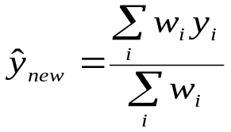
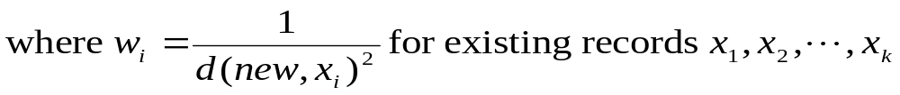
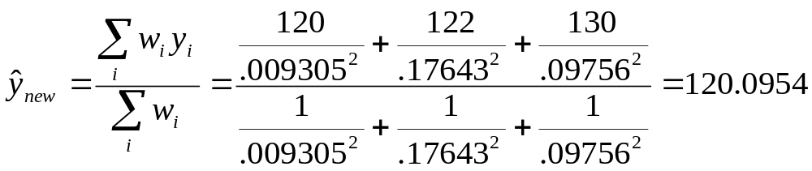
k-Nearest Neighbor Algorithm for Estimation and Prediction (cont’d)
  Assume BP has a range = 80, and minimum = 90
  We also stretch the axes for the Na/K ratio, to reflect its importance in estimating BP. In addition, we use the inverse square of the distances for the weights
  The estimated systolic blood pressure for the new record is:
  Since Record A is closest to the new record, its BP value of 120 makes a significant contribution to the estimated BP value
MD-MIS637-Fall 2020

Slide 38
Choosing k
  What value of k is optimal?
  There is not necessarily an obvious solution
Smaller k
  Choosing a small value for k may lead the algorithm to overfit the data
  Noise or outliers may unduly affect classification
Larger k
  Larger values will tend to smooth out idiosyncratic or obscure data values in the training set
  It the values become too large, locally interesting values will be overlooked
MD-MIS637-Fall 2020

Slide 39
Choosing k (cont’d)
  Choosing the appropriate value for k requires balancing these considerations
  Using cross-validation may help determine the value for k, by choosing a value that minimizes the classification error
MD-MIS637-Fall 2020

